Slide 1
Course Introduction
Prof. Dr. Dirk Riehle
Friedrich-Alexander University Erlangen-Nürnberg
NYT A01
Licensed under CC BY 4.0 International
Notes:
It is Friedrich-Alexander University Erlangen-Nürnberg – FAU, in short.
Corporate identity wants us to say “Friedrich-Alexander University”.

Slide 2
Course Learning Goals
Students will gain a conceptual understanding of
  Science in general
  The scientific process, including
    Types and forms of research
    Research methodologies and methods
    Publications and the scientific community
  How to write a research paper (thesis)

Slide 3
Definition of Science (Working Definition, First Take) [1]
Science is the process of acquiring knowledge for correct prediction and reliable outcome. [DR]
[1] Adapted from various sources.

Slide 4
Course Content
Science illustrated
Science defined
Theory building
Theory validation
Scientific writing
Publishing

Slide 5
Skills Required for Course
No particular requirements, but …
  Strong conceptual thinking

Slide 6
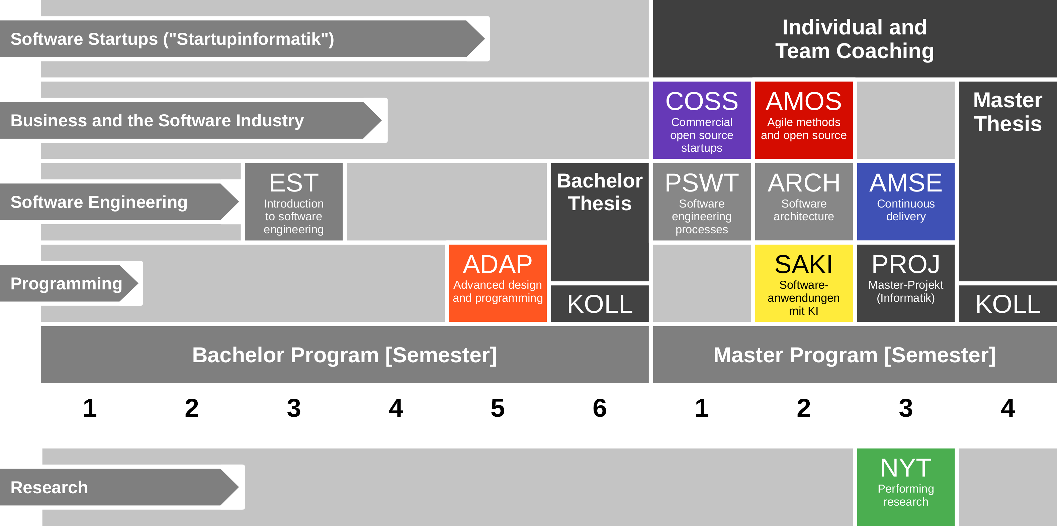
Course Position in Curriculum

Slide 7
Courses and Modules
 |  | Courses (Lehrveranstaltungen)
 |  | OSS-NYT-VUE | OSS-NYT-PROJ | Total ECTS
Modules | OSS-NYT- VUE | x | – | 5
 | OSS-NYT- PROJ | – | x | 5
 | OSS-NYT-VUE+PROJ | x | x | 10
NYT can be taken as
  5 ECTS VL + UE
  5 ECTS Seminar
  10 ECTS VL + UE
  10 ECTS Project
In various degree programs
Also as a Schlüsselqualifikation
VUE = Lecture + exercise (Vorlesung + Übung)
PROJ = Project

Slide 8
Course Grading [1]
Lecture-time contributions = 50% of total grade
  Lecture content (2 SWS) = 30 / 150 = 20% (of semester contributions)
    Graded using [0..10] each class session using StudOn quizzes
  Homework discussion (2 SWS) = 30 / 150 = 20% (of semester contributions)
    Graded using [0|1|2|3] scheme evaluated using class participation
  Homework submissions = 120 / 150 = 80% (of semester contributions)
    Graded using [0..10] based on grading rubric (see later slide)
Oral exam = 50% of total grade
  If both you and we agree on not having an oral exam, it can be dropped
    If there are questions about a student’s performance, we will not drop the oral exam
    If the oral exam is dropped, the semester contributions become 100% of the grade
[1] Also see http://osr.cs.fau.de/teaching/course-resources/grading-schemes-and-scales/

Slide 9
Class Quizzes
Each class session starts with a class quiz
  A quiz will test your understanding of last session’s lecture(s)
  A quiz typically has 5 questions and will last 10 minutes
  The overall quiz is graded using [0..10] scheme (10 points in total)
A class quiz will open precisely when class starts
  The quiz is administered automatically through StudOn
  It is your job to have reliable Internet access etc.
  There is no way to make up for a missed quiz
Please see the StudOn quiz FAQ at https://bit.ly/2JpgjnQ

Slide 10
Class Participation
Showing up +
listening to the lecturer +
thinking about what you are hearing +
verbalizing your thoughts (speaking up) +
answering to someone else's thoughts +
collaborating to solve a problem +
adequate use of air-time

Slide 11
Grading Rubric for Homework Submissions
Categories | Points |  |  |  |  | Criteria
 | Disagree | Disagree some | Neutral | Agree some | Agree
Form (10%) | Does the deliverable meet formal requirements? |  |  |  |  | Does the deliverable meet page length requirements, is written in the right language, etc.?
Language (10%) | Is the language clear, concise, and helpful? |  |  |  |  | Are sentences complete, is the grammar correct, are statements coherent, etc.?
Structure (20-30%) | Does the deliverable have a clear logical structure? |  |  |  |  | Does the deliverable follow established or suggested structure? Is the argument logical, etc.?
Content (50-60%) | Does the discussion touch on all relevant issues? |  |  |  |  | As a reference, use your own deliverable as well as what you learned in class.

Slide 12
Receiving a Grade for the Course
If you want to receive a grade
  You must register through the course management system during the registration period
If you cannot register through the course management system
  Please follow the instructions at https://wp.me/PDU66-2bx
Otherwise: No grade

Slide 13

No Oral or Written Exam [1]
[1] If both you and we don’t want to

Slide 14
Course Language [1]
Class
  Lecturer: English
  Student: Choice of German or English
Homework
  Instructor: English
  Submissions: Choice of German or English
[1] See http://osr.cs.fau.de/2012/03/10/english-or-german-deutsch-oder-englisch/

Slide 15

Course Communication
Announcements by email (through course management system)
Please ask your questions using the FSI Forum for this course
For email, use the teaching team alias from the Course Organization doc

Slide 16
Course Information
See Course Organisation doc at https://oss.cs.fau.de/oss-nyt-course

Slide 17
Thank you! Questions?
dirk.riehle@fau.de – http://osr.cs.fau.de
dirk@riehle.org – http://dirkriehle.com – @dirkriehle
DR

Slide 18
Credits and License
Original version
  © 2012-2020 Dirk Riehle, some rights reserved
  Licensed under Creative Commons Attribution 4.0 International License
Contributions
  ...

